Slide 1
How Do I “Motivate” My Students?
SMU Center for Teaching Excellence
Don Vandewalle, Chair
Management and Organizations Department
Cox School of Business

Slide 2
Opening Question
How can a professor enhance the motivation of the students in a class?
Activity: Meet in groups of ≈ 3, for 3 minutes, and develop 3 ideas.

Slide 3
PowerPoint Countdown Clock Info
http://www.m62.net/?s=clock&x=0&y=0
(I mainly use the fourth option on this web page)
http://download.cnet.com/BlingClock-Timer/3000-2350_4-10912976.html
http://people.uncw.edu/ertzbergerj/ppt_timers.html

Slide 4
Discussion Status
0
0
5
4
3
2
1
0
0
9
8
7
6
5
4
3
2
1
0
9
8
7
6
5
4
3
2
1
0
9
8
7
6
5
4
3
2
1
0
9
8
7
6
5
4
3
2
1
0
9
8
7
6
5
4
3
2
1
0
9
8
7
6
5
4
3
2
1
0
0
1
0
0
Hours
Minutes
Seconds

Slide 5
Part 1 Group Processing
In a classroom setting, why might a professor ask for ideas from small groups instead of individual class members?
3x3x3

Slide 6
Part 2 Group Processing
What motivation factors did your group identify?

Slide 7
Question 2
What are situations (outside of the classroom) when the mind of the typical 18-year old is completely captivated?
Activity: Groups of ≈ 2, for 2 minutes, for 2 ideas.

Slide 8
Note for: Captivation Ideas
Movies, video games, athletic contests, Pokémon cards, mystery novels, elections, experiments, crossword puzzles….
WHY: Surprise (unexpected) breaks one’s schema---- Gaps in knowledge with an itch to solve----A challenge to accomplish---- There’s a plot, story, or puzzle to figure out----One understands (connects to) the situation

Slide 9


Slide 10
Crucial Insight:
Understand motivation focus and source
        Extrinsic Motivation
        Intrinsic Motivation

Slide 11
Extrinsic Motivation
Engaging in an activity to attain (or avoid) an outcome of a reward or punishment. ≈Ryan & Deci, 2000

Slide 12
Intrinsic Motivation
Activity engagement for its inherent satisfactions of the joy and challenge (instead of merely the external outcomes)
≈Ryan & Deci, 2000

Slide 13
Should we focus on extrinsic or intrinsic motivation?

Slide 14
Note for: Both Are Useful
Extrinsic motivation may help capture the calendar
But, intrinsic motivation captures the heart, mind, and commitment.
So, be careful about relying on only extrinsic motivation to carry all of the weight for student motivation.

Slide 15
How do we facilitate intrinsic motivation in the classroom?
Five Concepts→

Slide 16
Passion
Purpose
Curiosity
Connection
Self-Efficacy

Slide 17
Passion

Slide 18


Slide 19
Dead Poets Society Clip
See this video clip for an example of the impact of passion for one’s discipline.
http://www.youtube.com/watch?v=tmayC2AdkNw

Slide 20
Purpose

Slide 21
Emotional Purpose
See this video clip for emotional purpose of a course.
http://www.youtube.com/watch?v=WIvmE4_KMNw

Slide 22
Instrumental Purpose
Course Evaluation Comment: “I’m majoring in finance to learn how to make money. I don’t see why I need a class in organizational behavior”
Enter: The Erik Peterson Case
Enter: Out of Control Case

Slide 23
Curiosity

Slide 24


Slide 25

Create Curiosity
Get Attention: Surprise with a schema break
Hold Attention:
Develop an interest with a knowledge gap

Slide 26
Why Is Curiosity Important?
A novel stimulus activates a dopamine release by the hippocampus, which eventually creates memory via new synaptic connections among nerves
(Fenker & Schütze, 2008)

Slide 27
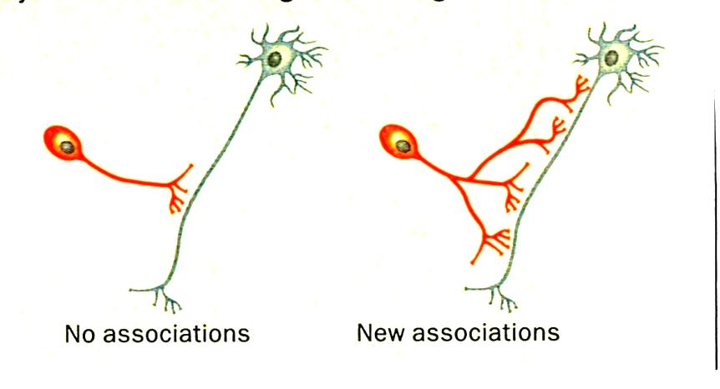

Slide 28
How can we foster curiosity in a class?
Two social science domain examples via opening puzzles→

Slide 29

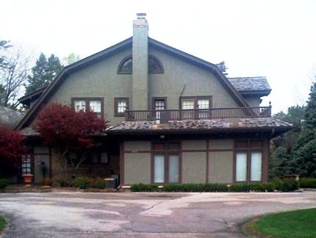
If 2 new Fortune 500 CEOs buy these homes, which stock should you buy?
$17 mil+ home of CEO A
<$1 mil home of CEO B

Slide 30
Three Learned Needs
  Need for Achievement
  Need for Power
  Need for Affiliation

Slide 31
Need for Power
Social power focus to benefit the collective greater good.
Personal power focus to benefit the self (instead of the collective greater good).

Slide 32
High Need for Power Behaviors
Socialized
• Responsible behaviors: mature, < manipulative
Personalized
• Impulsive behaviors: anger, gambling; aggressiveness
• Helps, supports others
• Abuses, uses others
• Participative, coaching style
• Authoritarian, controlling style
• Organizational goal focus
• Personal status and prestige focus.

Slide 33
If 2 new Fortune 500 CEOs buy these homes, which stock should you buy?
$17 mil+ home of CEO A
<$1 mil home of CEO B

Slide 34
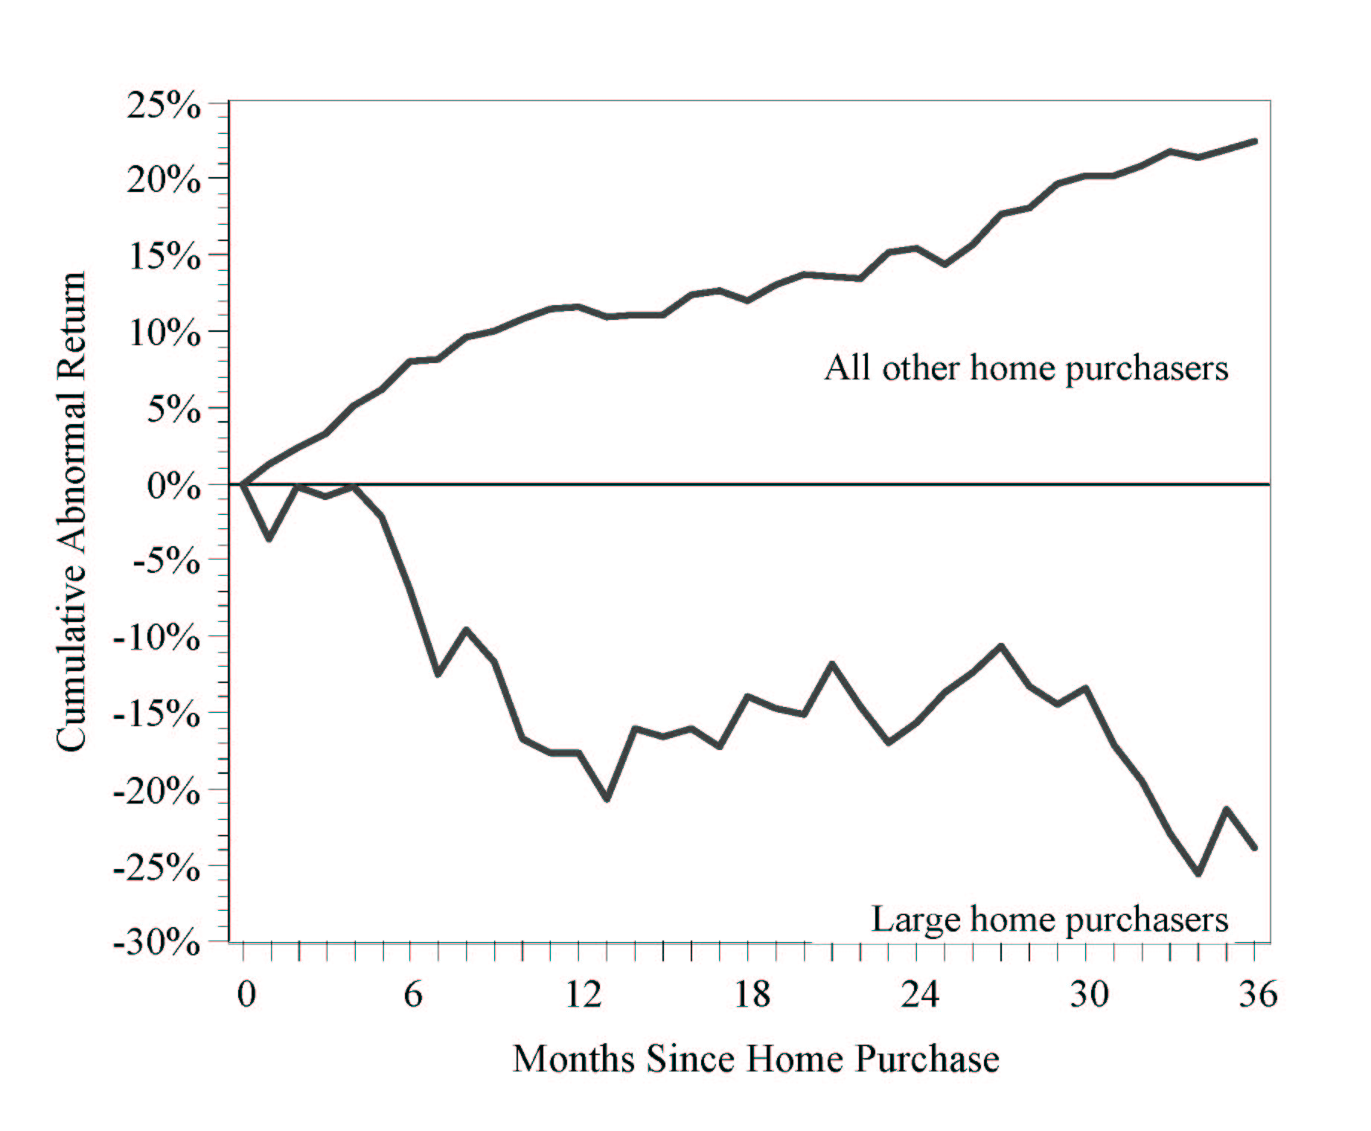
New CEO Home Size and Stock Performance
<10,000 Sq. Ft
S & P Return
>10,000 Sq. Ft &/or 10 acres

Slide 35
The McMansion Effect
(Liu & Yermack, 2007)
The cumulative difference between these two CEO groups equals:
  4.1 percent after three months
  15.0 percent after six months
  29.2 percent after one year
  46.2 percent after three years!

Slide 36
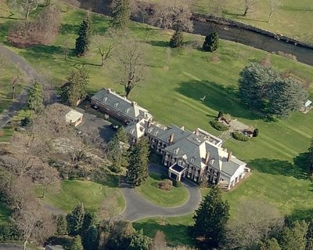
Merrill Lynch Poster Child John Thain

Slide 37
A Problem to Solve
Company: Forest Products Mill
Location: Rural Northwestern US
Focal Employees: 1000 line workers
Climate: Strong, militant union
Problem: Annual “shrinkage” of $1 mil+
Objective: Stop equipment theft
The Plan: How would you solve it?

Slide 38
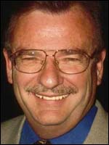
Consulting Adventure

Slide 39
Empathy Box Analysis: B = f(C)
Expected Consequence
Positive | Negative
Desired B: Honesty
Undesired B: Theft
Cell 1
Cell 2
Cell 3
Cell 4
Consultant Interview Findings:
1 Positive O for honesty? No PICs
2 Negative O for honesty? NIC retribution
3 Positive O of stealing? Major Thrills (PIC)
4 Negative O for theft? None identified

Slide 40
Key Action Needed? Change the behavior incentives: B = f(C) focus
Solution 1: Amnesty day to “return for a friend” (remove P+ for honesty)
Solution 2: Library system to borrow equipment (Defused R+ thrill for stealing)
Results: Let’s take a look→

Slide 41
{The materials were returned by the truckload. Amnesty was extended for another day. Yet more materials were returned by the truckload. Amnesty was extended to a third day as the garages, basements, and attics were finally liberated of years of looting...
The theft dropped to near zero immediately and remained so….}
----Latham (2001)

Slide 42
Stick in Action
CHECK LIST | YES/NO | HOW?
SIMPLE | √ | Understand Consequences
CURIOSITY | √ | Puzzle & surprise
CONCRETE | √ | Solve theft
CREDIBLE | √ | Actual research
INTERESTING | √ | Mystery novel
STORY | √ | Mystery novel

Slide 43
Psychology—50 Great Myths of Popular Psychology
Economics—SuperFreakonomics: Global Cooling, Patriotic Prostitutes, and Why Suicide Bombers Should Buy Life Insurance
Math—Guesstimation: Solving the World's Problems on the Back of a Cocktail Napkin
Anthropology and Archaeology— Frauds, Myths, and Mysteries: Science and Pseudoscience in Archaeology
Statistics—More Damned Lies and Statistics: How Numbers Confuse Public Issues

Slide 44
Connection

Slide 45
Understanding Connection
J FKFB INAT OUP SNA SAI RS
View for 10 seconds and memorize the letters

Slide 46
Understanding Connection
Write down the letters:
J FKFB INAT OUP SNA SAI RS
Easier to remember now?
JFK FBI NATO UPS NASA IRS

Slide 47
The Science of Connection
  We learn when we can relate to what we already know (Greene, 2010)

Slide 48


Slide 49
Communication Barriers
Barrier: Curse of Knowledge
Expert
Non Expert
Barrier: Lack of Common Language

Slide 50

Curse of Knowledge—Jon Rousay, EMBA ‘13

Slide 51
The Elevator Pitch
See this video clip for a contrast of messages that connect and don’t connect
http://www.youtube.com/watch?v=vuH55vUTfVQ

Slide 52
Self-efficacy

Slide 53


Slide 54


Slide 55


Conveys Belief
Self Beliefs
Actions
Actions

Slide 56
Self-Efficacy Enhancement
Convey high expectations
Convey a growth mindset
Model the desired outcomes
Provide constructive feedback

Slide 57
A RECAP
Passion
Purpose
Curiosity
Connection
Self-Efficacy

Slide 58
Discussion Philosophy
Focus on the underlying principles of motivation that provide frameworks for application across disciplines
VERSUS
Focus on very specific tactics of motivation with potential application to a limited range of disciplines.

Slide 59


Slide 60

Bad textbooks

Slide 61
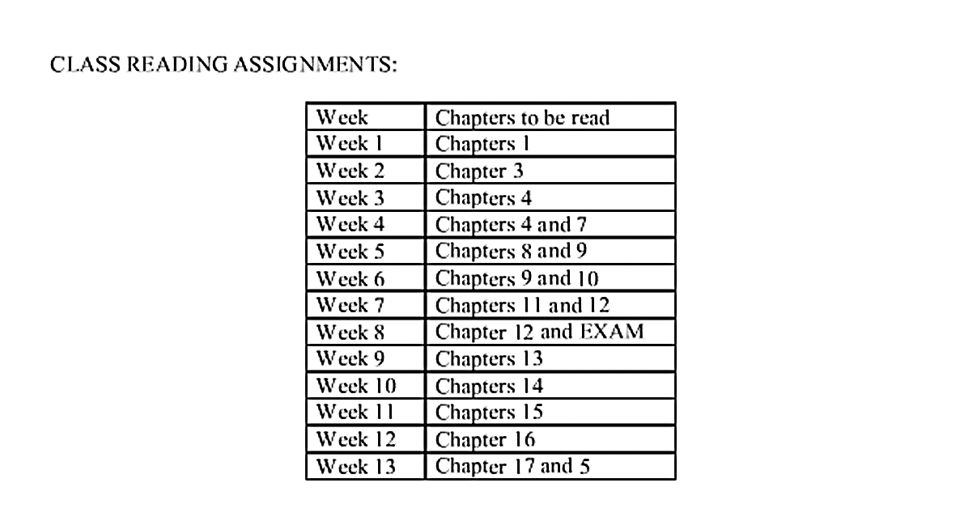
Teaching to a
bad textbook

Slide 62
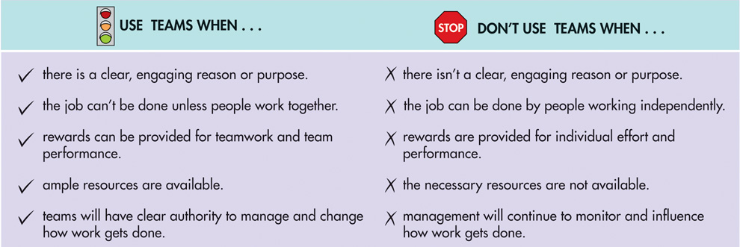
When to Use Teams
Bad PowerPoint
from the textbook publisher
Exhibit 10.3
1.3
Notes:
Sources: R. Wageman, “Critical Success Factors for Creating Superb Self-Managing Teams,” Organizational Dynamics 26, no. 1 (1997): 49-61.
First, teams should be used where there is a clear, engaging reason or purpose for using them. Too many companies use teams because they're popular or because they assume that teams can fix all problems. But teams are much more likely to succeed if they know why they exist and what they are supposed to accomplish. Second, teams should be used when the job can't be done unless people work together. This typically means that teams are required when tasks are complex, require multiple perspectives, or require repeated interaction with others to complete. However, if tasks are simple and don't require multiple perspectives or repeated interaction with others, teams should not be used. Third, teams should be used when rewards can be provided for teamwork and team performance. Team rewards that depend on team performance rather than individual performance are the key to rewarding team behaviors and efforts. Fourth, teams should be used when ample resources are available. The resources that teams need include training (discussed later in the chapter), sufficient time and a place or method to work together, job-specific tools, and consistent information and feedback concerning team work processes and job performance. Another key problem with resources is management resistance. Managers who have been in charge are often reluctant to help teams or turn over resources to them.

Slide 63

Lack of challenge

Slide 64

The book that has influenced my teaching the most in the pats decade →

Slide 65


